Slide 1
CS 575
Design and Analysis of
Computer Algorithms
Professor Michal Cutler
Recurrences

Slide 2
This topic
Recursion
  Recursive definitions and corresponding code
  How recursion is executed
  Writing the recurrence equation for the count of a given recursive code
Recursion tree method
Substitution method
Iteration
The master theorem
Application examples of Master theorem

Slide 3
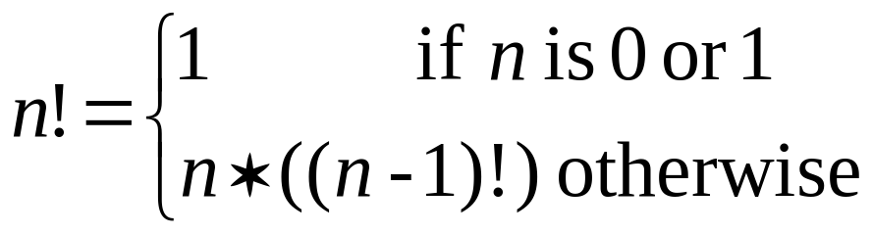
Recursion
What is the recursive definition of n! ?
Translating to Java/c
    int fact(int n) {
    if (n<=1) return 1;
    // Note '*' is done after returning from fact(n-1)
    else return n*fact(n-1);
    }

Slide 4
Recursive algorithms
A recursive algorithm typically contains recursive calls to the same algorithm
In order for the recursive algorithm to terminate, it must contain code for solving directly some “base case(s)”
A direct solution does not include recursive calls.

Slide 5
A Call Tree for fact(3)
The Run Time Environment
The following 2 slides show the program stack after the third call from fact(3)
When a function is called an activation records('ar') is created and pushed on the program stack.
The activation record stores copies of local variables, pointers to other ‘ar’ in the stack and the return address.
When a function returns the stack is popped.
returns 6
fact(3)
6
*
3
fact(2)
2
*
2
fact(1)
1
1
  int fact(int n) {
  if (n<=1) return 1;
  else return n*fact(n-1);
  }

Slide 6
AR=Activation Record
ep= environmental pointer
free memory
N =1
function value [=1]
AR(fact 1)
return address
free memory
static link = ep0
dynamic link = EP
EP
N =2
N =2
function value [=2]
function value [=?]
AR(fact 2)
return address
AR(fact 2)
return address
static link = ep0
static link = ep0
dynamic link = EP
dynamic link =ep2
ep2
EP
N =3
N =3
function value [=?]
function value [=?]
AR(fact 3)
return address
AR(fact 3)
return address
static link = ep0
static link = ep0
dynamic link =ep1
dynamic link = ep1
ep1
ep1
Val
AR(Driver)
Val
AR(Driver)
fact: <ipF,ep0>
fact: <ipF,ep0>
ep0
ep0
Program stack
Program stack
Snapshot of the environment
Snapshot of the environment
at end of third call to fact
at end of second call to fact

Slide 7
free memory
N =3
function value [=6]
AR(fact 3)
return address
static link = ep0
dynamic link = EP
EP
free memory
Val
Val
AR(Driver)
fact: <ipF,ep0>
AR(Driver)
fact: <ipF,ep0>
EP
ep0
Program stack
Program stack
Snapshot of the environment
at end of first call to fact
Snapshot of the environment
after fact l returns

Slide 8
Tower of Hanoi http://www.mazeworks.com/hanoi/
Game in which you have disks of different sizes, and three pegs on which you can place the disks.
You cannot put a larger disk on top of a smaller one, and you are allowed to move only one disk at a time.
How many moves would it take to transfer n disks from one peg to another (stacked in decreasing size with the largest one at the bottom)?

Slide 9
Tower of Hanoi
Hanoi(nDisks, start, destination, spare)
if (nDisks > 0)
Hanoi(nDisks - 1, start, spare, destination)
move disk from start to destination //O(1)
Hanoi(nDisks - 1, spare, destination, start)
return

Slide 10
Fibonacci
recursiveFib(n) {
if (n <=1) {
return n;
}
return recursiveFib(n-1) +
recursiveFib(n-2)
}

Slide 11
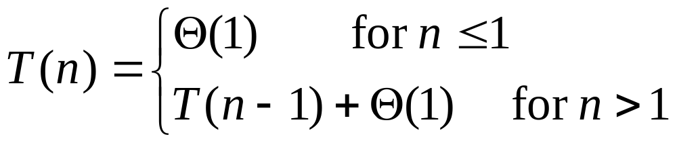
Recurrence equation for Factorial
int fact(int n) {
    if (n<=1) return 1;
    // Note '*' is done after returning from fact(n-1)
    else
    return n * fact(n-1);
Operations
counted in
The only recursive
call, requiring
T(n - 1) operations

Slide 12
Deriving a Recurrence Equation for Mystery
In this example we are not concerned with what mystery computes. Our goal is to simply write the recurrence equation for the instruction count
mystery (n)
if n ≤ 1
then return n
else return (5 * mystery(n -1)
- 6* mystery(n -2) )

Slide 13
Recursion trees method for solving the recurrence equation
The tree represents an estimate of all the instructions executed by the recursive algorithm.
The tree is expanded one depth at a time.
In the final tree:
  Each “recursive call” is represented by a node containing the “non recursive” number of operations done during the call (t(size))
The number of operations is summed for each depth, and then over the depths
Notes:
Examples:
T(n)=T(n-1)+1
T(n)=T(n/2)+1
T(n)=2T(n/2)+n^2
T(n) = T(n/4) + T(n/2) + n^2.

Slide 14
MergeSort
mergeSort(a, left, right ) {
if( left < right ) {
mid = ( left + right ) / 2
mergeSort( a, left, mid );
mergeSort( a, mid + 1, right );
merge( a, left, mid + 1, right );
}
}

Slide 15
Recursion tree for MergeSort (MS)
MS(n)
T(n)
Initially, the recursion tree is a node containing the call to MS(n), and total amount of work in the worst case, T(n).
When we unroll the computation this node is replaced with a subtree:
The root of the subtree contains the call to MS(n) , and the “nonrecursive work” for this call t(n).
The two children contain a recursive call to MS(n/2), and the total amount of work in the worst case for this call, T(n/2).

Slide 16
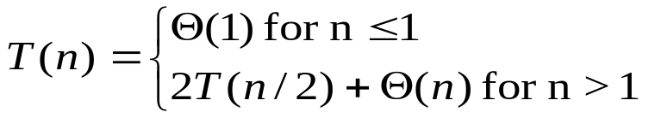
After first unrolling of mergeSort
MS(n)
depth nd T(n)
t(n)=Θ(n)
0 1 Θ(n)
MS(n/2)
MS(n/2)
T(n/2)
T(n/2)
2T(n/2)
nd = number nodes at depth d

Slide 17
After second unrolling
depth nd T(n)
MS(n)
Θ(n)
0 1 Θ(n)
MS(n/2)
MS(n/2)
1 2 Θ(n)
Θ(n/2)
+
Θ(n/2)
MS(n/4)
MS(n/4)
MS(n/4)
MS(n/4)
T(n/4)
T(n/4)
T(n/4)
T(n/4)
4T(n/4)

Slide 18
After third unrolling
depth nd T(n)
MS(n)
Θ(n)
0 1 Θ(n)
MS(n/2)
MS(n/2)
1 2 Θ(n)
Θ(n/2)
+
Θ(n/2)
MS(n/4)
MS(n/4)
MS(n/4)
MS(n/4)
2 4 Θ(n)
Θ(n/4)
+
Θ(n/4)
+
Θ(n/4)
+
Θ(n/4)
MS(n/8)
MS(n/8)
. . . . . . .
MS(n/8)
8T(n/8)
T(n/8)
T(n/8)
T(n/8)

Slide 19
Terminating the unrolling
For simplicity let n = 2^{k}
lg n = k
When a node has a call to MS(n/2^{k}):
  The size of the input to merge-sort is DirectSolutionSize since n/2^{k} = 1
  In this case the unrolling terminates, and the node is a leaf containing DirectCount = Θ(1)

Slide 20
The recursion tree (excluding the calls)
d nd T(n)
Θ (n/2⁰)
0 1 Θ (n)
Θ (n/ 2¹)
Θ (n / 2¹)
1 2 Θ (n)
Θ (n / 2²)
Θ (n/ 2²)
Θ (n/ 2²)
Θ (n / 2²)
2 4 Θ (n)
Θ (n / 2³)
Θ (n / 8)
Θ (n / 8)
Θ (n / 8)
Θ (n / 8)
Θ (n / 8)
Θ (n/ 8)
Θ (n / 8)
3 8 Θ (n)
Θ (1)
Θ (1)
k 2^{k} Θ (n)
T(n)= (k+1) Θ (n) = Θ( n lg n)

Slide 21
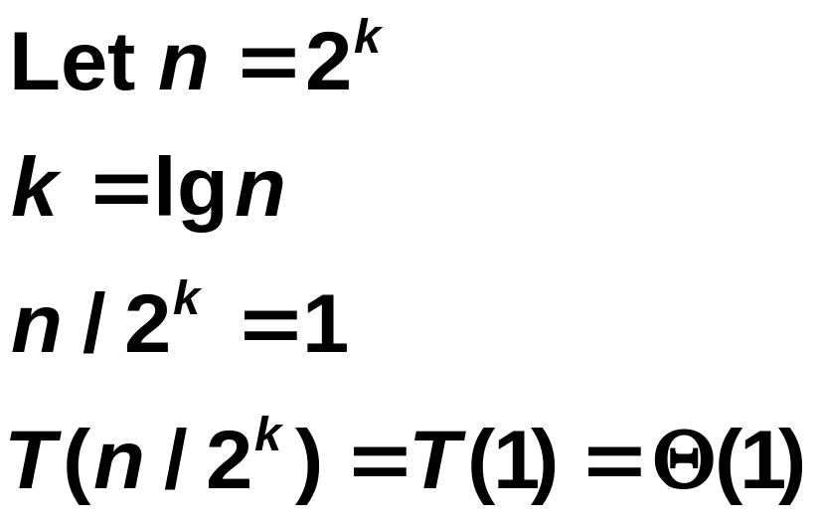
T(n)=2T(n/2)+n²
n²
T(n/2)
T(n/2)

Slide 22
T(n)=2T(n/2)+n²
n²
(n/2)²
(n/2)²
T(n/4)
T(n/4)
T(n/4)
T(n/4)

Slide 23
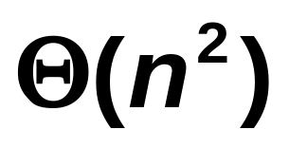
The recursion tree for T(n)
0
n²
n²
1
(n/2)²
(n/2)²
(1/2) n²
2
(n/4)²
(n/4)²
(n/4)²
(n/4)²
(1/4) n²
.
.
.
.
.
.
lgn

Slide 24
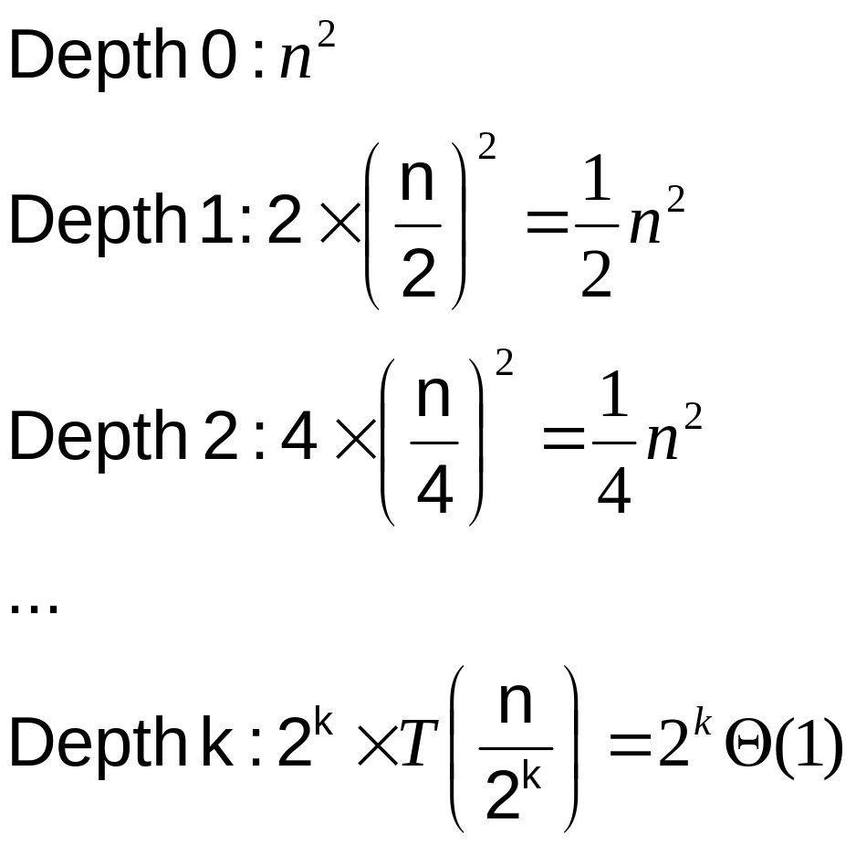
Recursion trees

Slide 25
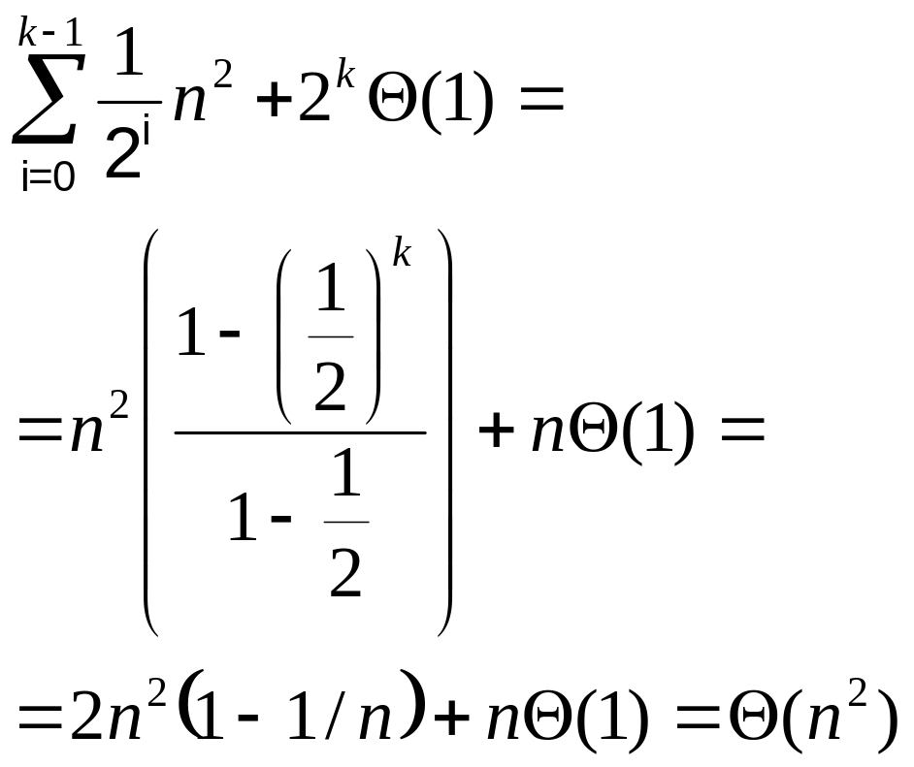
Recursion trees

Slide 26
The substitution method
We guess the form of the solution (from experience mostly).
We then verify the solution and solve for constants.
Not possible to guess correctly in every case.
T(n) = 4T(n/2) + n
We guess O(n³) and show T(n) ≤cn³ for all n≥n₀

Slide 27
Example (cont.)
We assume that T(k) ≤ ck³ for k < n and prove T(n) ≤ cn³ by induction.
T(n)=4T(n/2) + n ≤ 4c(n/2)³ + n =
= (c/2)n³ + n = cn³ - ((c/2)n³ - n) ≤ cn³
provided (c/2)n³ - n ≥0
So (c/2)n³ ≥ n and c ≥ 2/n² for all n≥1
c≥2 and n≥1

Slide 28
Initial Condition
Assume that T(1)=3
3=T(1)≤c1³=c . So c≥max{3, 2}=3.

Slide 29
A tighter bound
Improve bound to T(n)=O(n²)
We assume that T(k) ≤ ck² for k < n and prove T(n) ≤ cn².
T(n)=4T(n/2) + n≤4c(n/2)² + n =
= cn² + n.
Bad guess! Try T(n)≤c₁n²-c₂n

Slide 30
Subtract a lower term
We assume that T(k) ≤ c₁k²-c₂k for k < n and prove T(n) ≤ c₁n²-c₂n.
T(n)=4T(n/2) + n≤4(c₁(n/2)² - c₂n/2)+ n = c₁n² - 2c₂n +n ⁻= (c₁n² - c₂n) - (c₂n - n) ≤ (c₁n² - c₂n)
only if c₂n- n≥0 and c₂≥1 for n≥1
Since T(1)=3 ≤ c₁1² - c₂1 we pick c₁=4 and c₂=1

Slide 31
The iteration method
We expand the recursion,
then get a summation,
then compute the summation using algebraic methods.

Slide 32
The iteration method
We have to know rules for summations to use this method.
We often use this method to guess the solution for the substitution method.

Slide 33
Example
T(n) = n + 4T(n/2)
= n + 4(n/2 + 4T(n/4))=
= n + 2n + 16(n/4 + 4T(n/8))=
= n + 2n + 4n + 64(n/8 + 4T(n/16))=
Let n=2^{k} and k=lgn
To generalize we have to write the sum when T(n/2^{k} )=T(1)=Theta(1)

Slide 34
Generalize
We look at the following values:
In line 1: n 4 n/2
In line 2: 2n 4² n/2²
In line 3: 2²n 4³ n/2³
In line k: 2^{k-1}n 4^{k} n/2^{k}
So the full line is:
n + 2n + 2²n + 2³n + …+2^{k-1}n + 4^{k}T(n/2^{k})

Slide 35
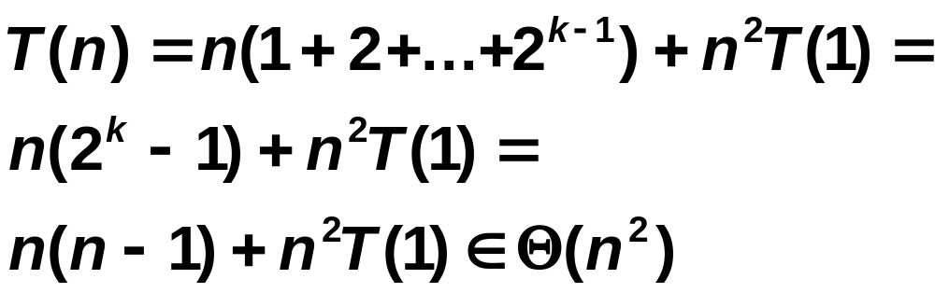
Example (cont)
We know 4^{lg n}=n^{lg4} =n² (because a^{lgb} = b^{lga})

Slide 36
The Master method
Used to solve equations of the form
T(n) = aT(n/b) + f(n)
where a ≥1,
b > 1,
and f(n) is an asymptotically nonnegative function.
Note: Version more general than one in text

Slide 37
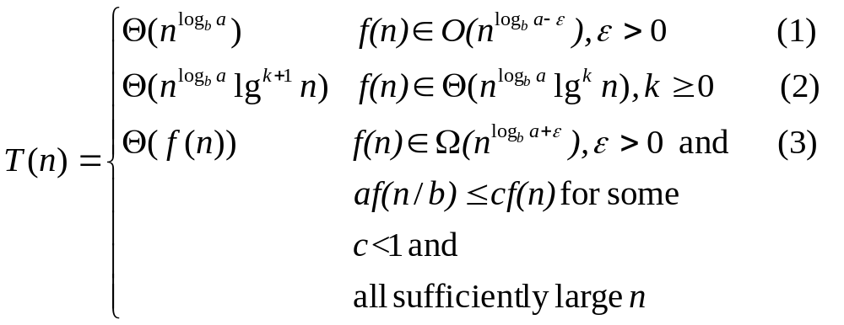
Master theorem

Slide 38
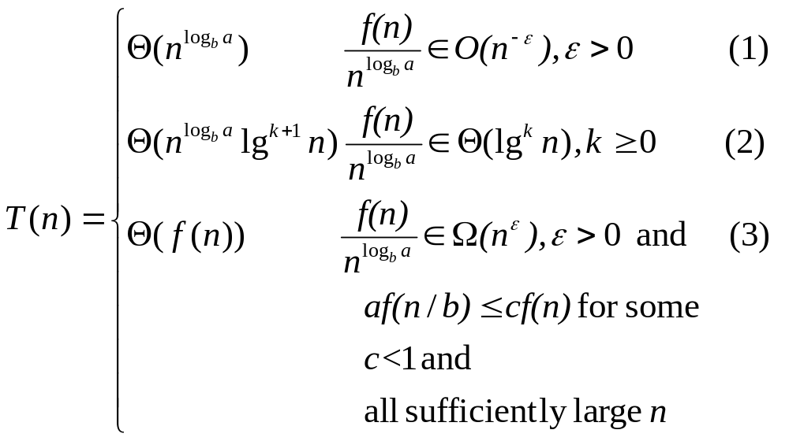
Master theorem

Slide 39
The recursion tree
(integer a)
f(n)
f(n)
f(n/b)
f(n/b)
f(n/b)
af(n/b)
f(n/b²)
f(n/b²)
f(n/b²)
a²f(n/b²)
k
Θ(1) Θ(1) Θ(1) Θ(1) Θ(1) Θ(1) Θ(1) Θ(1) Θ(1) a^{k} Θ(1)
n=b^{k}, k=log_{b}n, T(n/b^{k} )=T(1)= Θ (1)

Slide 40
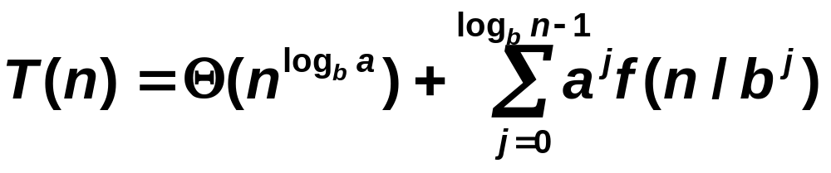
The Master method
Let n=b^{k} and k=log_{b}n.
The number of leaves in the recursion tree is a^{logbn} = n^{logba}.

Slide 41
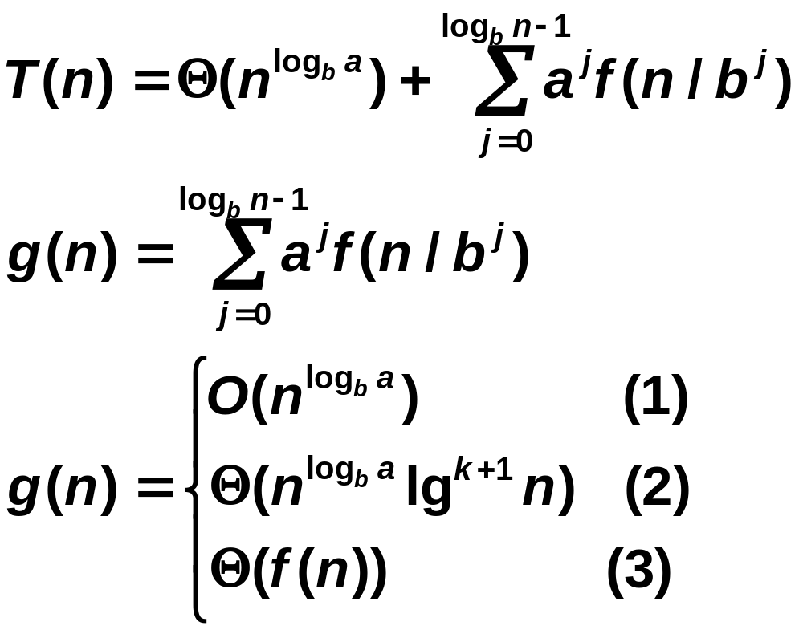
The Three Cases

Slide 42
Case 1: n^{logba} is polynomially larger than f(n).
f(n)= O(n^{logba-ε}), or
f(n)/n^{logba} = O(n^{-ε}) , or
n^{logba}/ f(n) = Ω(n^{ε})
for some constant ε > 0
We bound the sum within the O-notation by factoring the terms, the remaining sum is an increasing geometric series

Slide 43
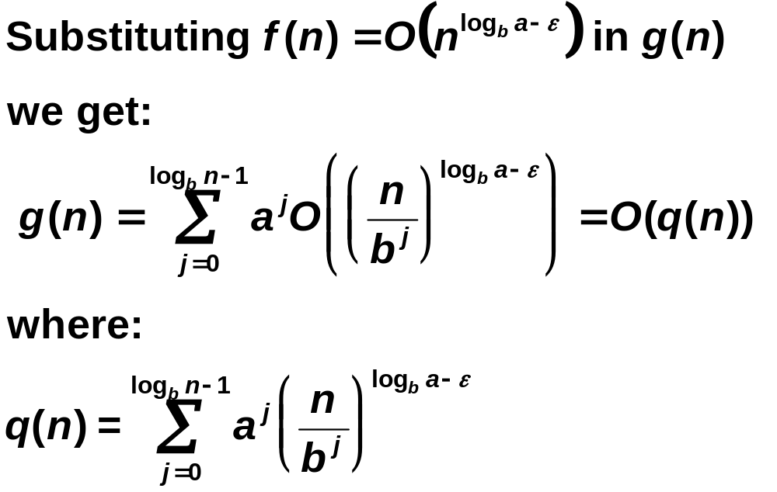
g(n) for case 1

Slide 44
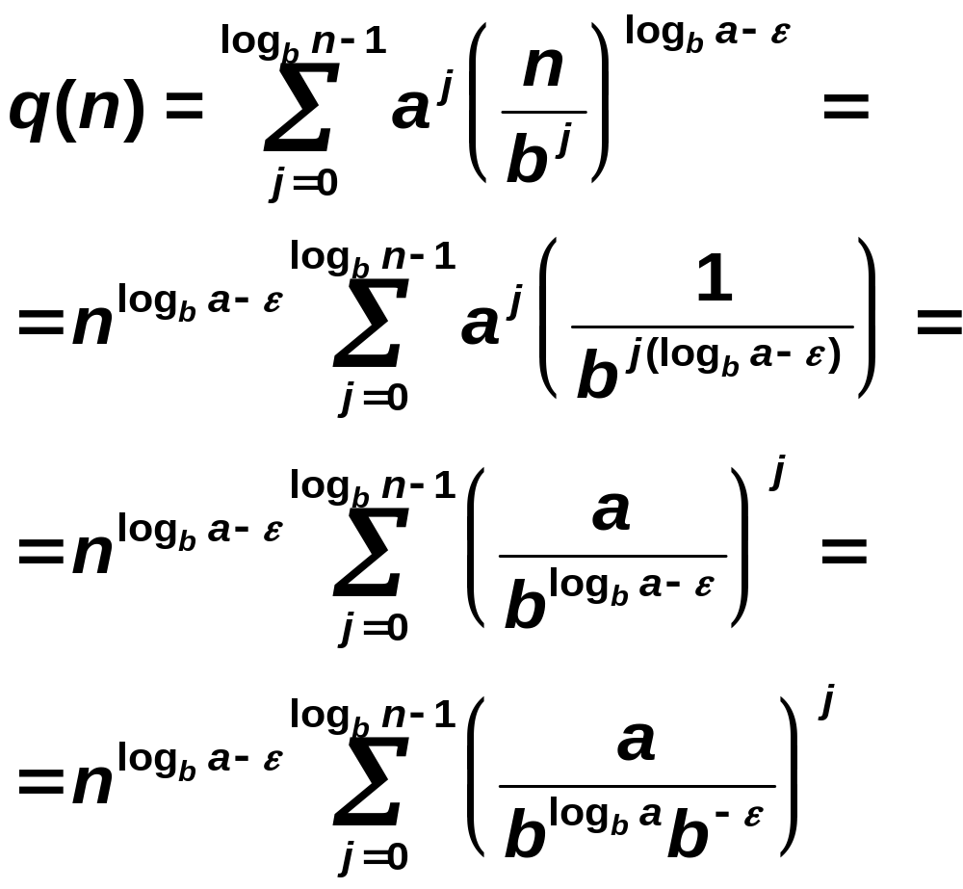
g(n) for Case 1

Slide 45
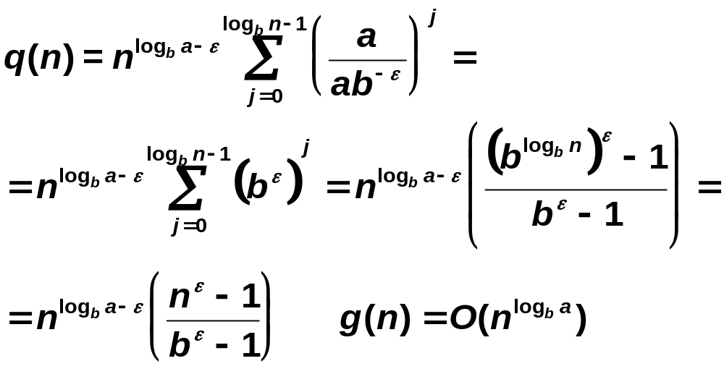
g(n) for Case 1

Slide 46
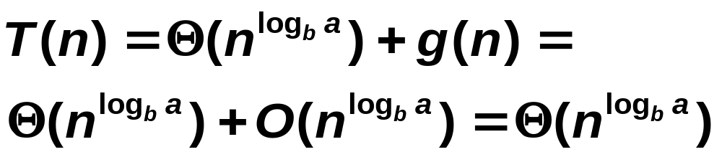
Case 1: n^{logba} is polynomially larger than f(n).
Total weight is (constant *number leaves).

Slide 47
Case 2: n^{logba} and f(n) are within a polylogarithmic factor.
f(n)/ n^{logba} = Θ(lg^{k}n) for some constant k≥0.
T(n) = Θ(n^{logba}) + Θ(n^{logba} lg^{k+1}n)=
= Θ(n^{logba} lg^{k+1}n)

Slide 48
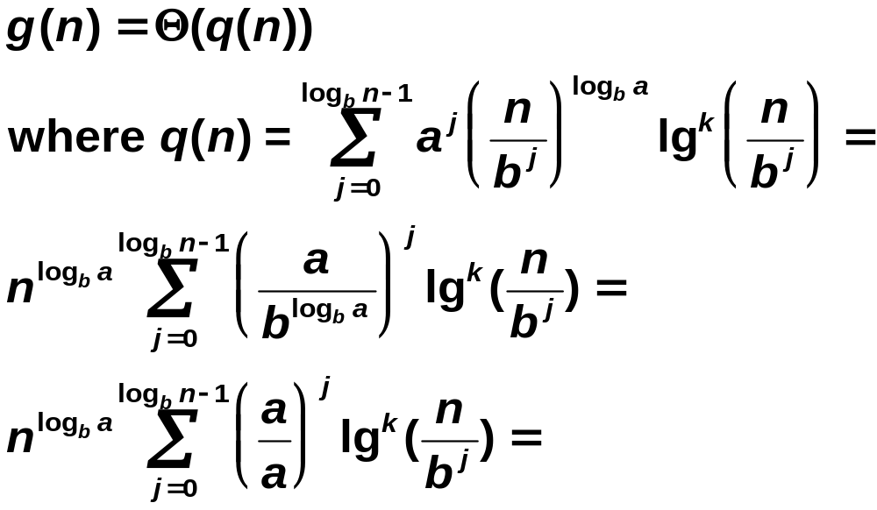
g(n) for Case 2

Slide 49
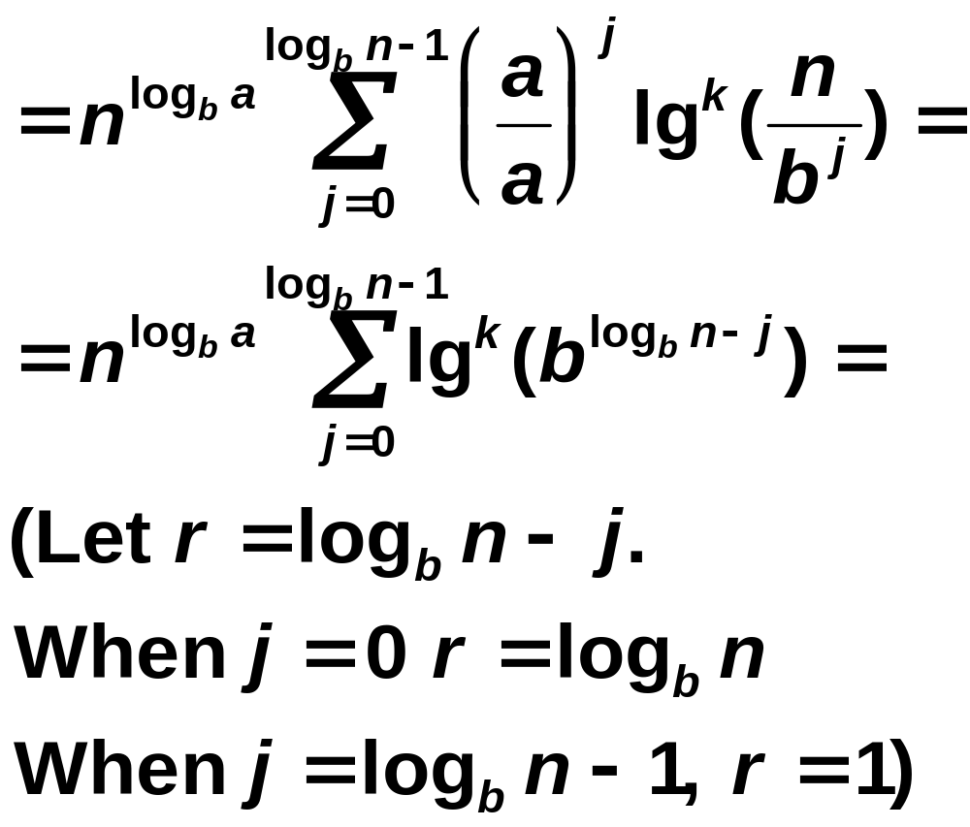
g(n) for Case 2

Slide 50
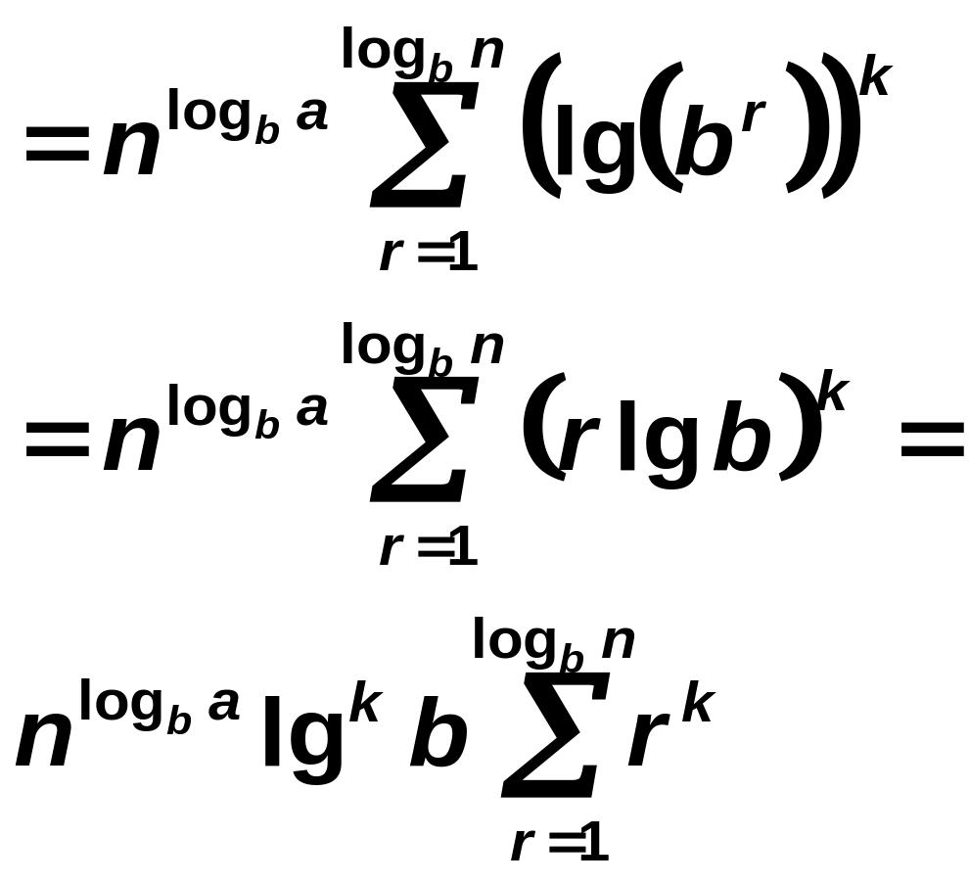
g(n) for Case 2

Slide 51
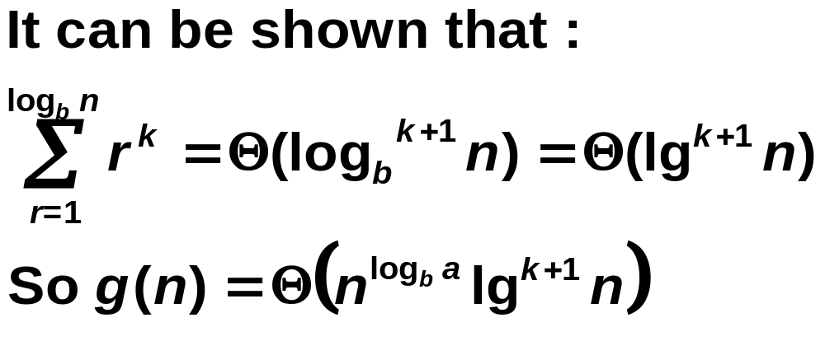
g(n) for Case 2

Slide 52
Case 3: n^{logba} is polynomially smaller than f(n).
f(n)/ n^{logba} = Ω (n^{ε}) for some constant ε > 0.
Total weight is (constant times weight of root).
T(n) = Θ(n^{logba}) + Θ(f(n))= Θ(f(n))

Slide 53
Case 3: n^{logba} is polynomially smaller than f(n).
We will show that
1. g(n)= Ω(f(n)), and
2. g(n)=O(f(n)) and therefore
g(n)= Θ(f(n))

Slide 54
Case 3: n^{logba} is polynomially smaller than f(n).
1. We know that a≥1 and that f(n)≥0 for all large enough n
So all terms of g(n) are nonnegative for large enough n.
The first term of g(n) is f(n), so g(n)≥f(n) for all large enough n and g(n)=Ω(f(n))

Slide 55
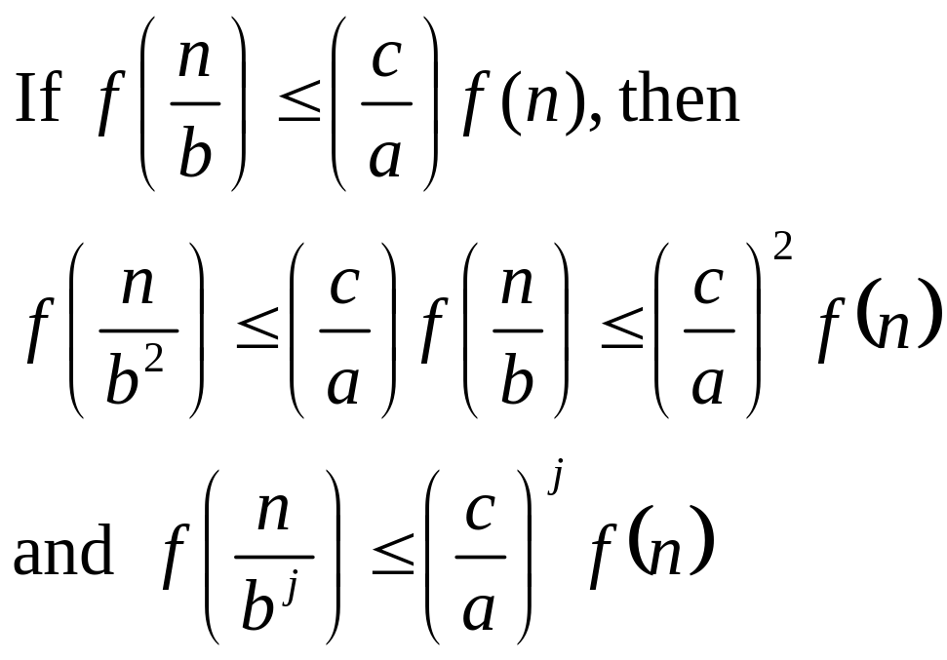
Case 3

Slide 56
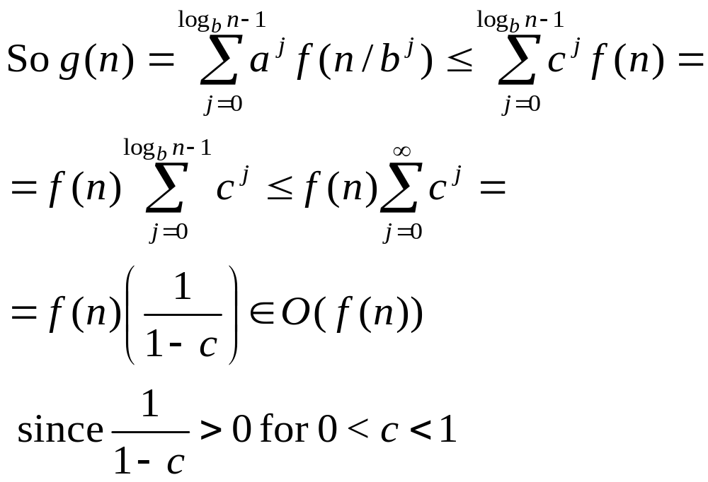
Case 3

Slide 57
Master method examples
T(n) = 2T(n/2) + Θ(n)
a = b =2
f(n)= Θ(n)
n^{log22} = n,
Θ(n)/n = Θ(1) = Θ(lg⁰n)
Case 2 and T(n)= Θ(nlgn)

Slide 58
Master method examples
T(n) = 7T(n/2) + Θ(n²).
a =7, b = 2
n^{logba} = n^{log27}
Θ(n²)/n^{log27} = Θ(n^{2-lg 7}) = Θ(n^{-0.8})
Case 1 and T(n) = Θ(n^{log27})

Slide 59
Master method examples
T(n) = T(n/2) + Θ(1)
Since n^{log21} = n⁰ = 1, Θ(1)/1 = Θ(log⁰n), we are dealing with Case 2 and T(n) = Θ(log n)

Slide 60
Master method examples
T(n) = 4T(n/2) + n³
Since n³/n^{lg4} = n, we are dealing with Case 3.
Is af(n/b) <= cf(n) for some c<1 and all sufficiently large n? yes
4(n/2)³ =n³/2 so c=1/2
So T(n) = Θ(n³)
The master method does not solve all recurrences of the given form.

Slide 61
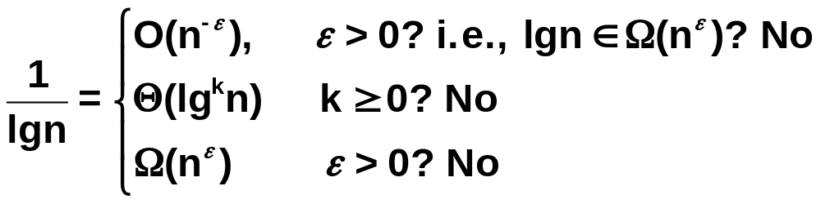
Master method fails
T(n) = 4T(n/2) + n²/lgn
(n²/lgn)/n² = 1/lgn and no case applies

Slide 62
Master method fails
The solution is T(n) = Θ(n²lglgn) and can be verified by the substitution method.
Iteration can also be used and then the sum of the Harmonic series

